Slide 1
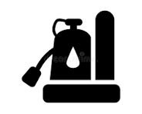

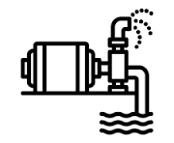








Spring Jobsite Prep Checklist For Contractors, Builders & Excavation Companies
Get your jobsites ready for spring startup. Avoid delays, protect productivity, and ensure your crew has the equipment they need to move fast.
Conditions & Site Access
Confirm excavation areas are marked and cleared
Earthmoving & Site Prep
Inspect site for mud, soft ground, and winter damage
Productivity & Safety
Plan how materials will be moved across site efficiently
Confirm access roads are stable and passable
Plan ground protection if conditions are still wet
Identify drainage issues or standing waste
Inspect trench areas for collapse risk after freeze/thaw
Plan grading and leveling work
Schedule equipment needed for early site work
Confirm lifting equipment for framing, steel, or materials
Ensure operators have safe access to elevated work areas
Power, Pumping & Site
Inspect owned equipment for winter damage
Equipment Readiness
Plan temporary power needs
Safety & Readiness
Confirm safe access and walkways
Remove water accumulation from thaw and spring rains
Ensure dust control readiness
Confirm maintenance and service needs are up to date
Identify equipment gaps before work begins
Check trench safety compliance
Ensure crews have proper access equipment
Review lifting plans and equipment needs
miltonrents.com
877-DIG-LIFT

